Slide 1
IBM University Engagement Project Submission
“Exploring the Power of Agentic AI with IBM Cloud and Orchestrate”

Slide 2

Project Tile – AI Agent for Smart Farming Advice
Domain of Project – Agriculture Technology
Student Name | Recent Passport Photo | Email ID | Mobile number [WhatsApp]
Payal Himmat Karvande |  | payalkarvande10@gmail.com | 9579500549

Slide 3
Problem Statement -
Problem Statement : FarmaAgent – AI-Powered Smart Farming Advisor
The Challenge
Agriculture faces challenges such as unpredictable weather, pest and disease outbreaks, declining soil fertility, inefficient irrigation, and fluctuating market prices. Farmers often lack timely access to reliable, personalized agricultural advice, leading to lower crop yields and reduced income. Existing farming information is scattered across multiple sources, making it difficult for farmers to make informed decisions.
The Objective
Build an AI-powered Smart Farming Agent that delivers personalized agricultural insights and recommendations to help farmers improve productivity, reduce costs, and adopt sustainable farming practices. The solution should:
Agricultural Knowledge Retrieval (RAG) – Retrieve crop-specific best practices, farming techniques, and government agricultural advisories from trusted sources.
Weather & Soil Insights – Provide real-time weather forecasts, soil health analysis, and irrigation recommendations to support farm planning.

Slide 4
Proposed Solution -
Proposed Solution: AI-Powered Smart Farming Agent (FarmaAgent)
The proposed solution is FarmaAgent, a multi-agent AI-powered Smart Farming Assistant built using IBM LangFlow, IBM watsonx.ai, IBM Granite Models, and IBM Orchestrate. It provides personalized, real-time agricultural guidance to help farmers improve crop productivity, reduce costs, and adopt sustainable farming practices.
The solution uses a Retrieval-Augmented Generation (RAG) pipeline to retrieve trusted agricultural information such as crop guidelines, government advisories, soil management practices, and farming best practices. This knowledge is stored in a vector database, enabling the system to provide accurate, context-aware recommendations using IBM Granite Models.
The system consists of four intelligent agents:
Crop Advisory Agent – Recommends suitable crops, seed varieties, fertilizers, irrigation schedules, and harvesting timelines based on the farmer's location, soil type, and season.
Weather & Irrigation Agent – Provides real-time weather forecasts, rainfall alerts, and irrigation recommendations for efficient water management.

Slide 5
Technology Used
IBM LangFlow – For designing and orchestrating the multi-agent workflow, enabling collaboration between Crop Advisory, Weather & Irrigation, Pest & Disease Detection, and Market Insights agents.
IBM Granite Model (e.g., ibm-granite-3-2-8b) – For natural language understanding, reasoning, personalized farming recommendations, and answering user queries.
IBM Cloud – Provides a secure, scalable, and reliable platform to deploy and manage the FarmaAgent application and its AI services.
Retrieval-Augmented Generation (RAG) – Retrieves trusted agricultural knowledge, crop guidelines, government advisories, and farming best practices before generating accurate responses.
IBM watsonx.ai – Used for model deployment, embeddings, AI governance, and powering the AI capabilities of FarmaAgent.
Vector Database (FAISS/Chroma) – Stores agricultural knowledge embeddings for fast and accurate RAG-based information retrieval.

Slide 6
OrchestrAate component Used -
Chat Input- Interface where farmers enter their queries, upload crop images, or provide details such as crop type, soil type, location, and farming issues.
2) IBM watsonx AI Agent (FarmaAgent)- Processes user input using IBM Granite models to provide personalized crop recommendations, weather insights, pest detection, irrigation guidance, and market advice.
3) IBM Granite Model- Granite-4.0-8B-Instruct → Fast and efficient for natural language understanding, agricultural reasoning, and personalized farming recommendations.
4) Chat Output- Displays AI-generated responses such as crop recommendations, weather-based irrigation schedules, pest and disease diagnosis, fertilizer suggestions, and market insights.
5) File Component- Stores and retrieves agricultural documents, government advisories, crop guidelines, and user-uploaded crop images for RAG-based retrieval and analysis.

Slide 7
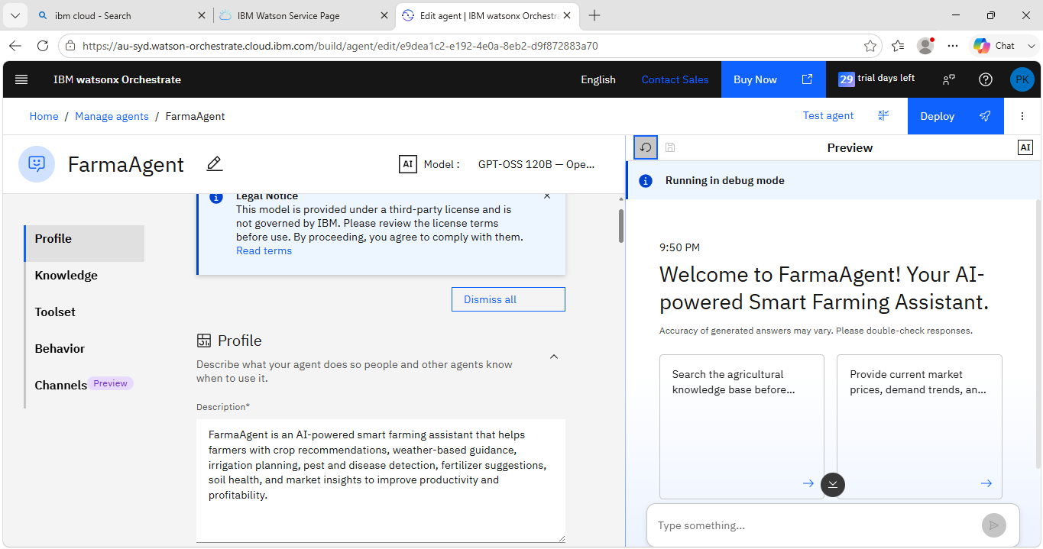
Agent Instructions Screenshot-

Slide 8
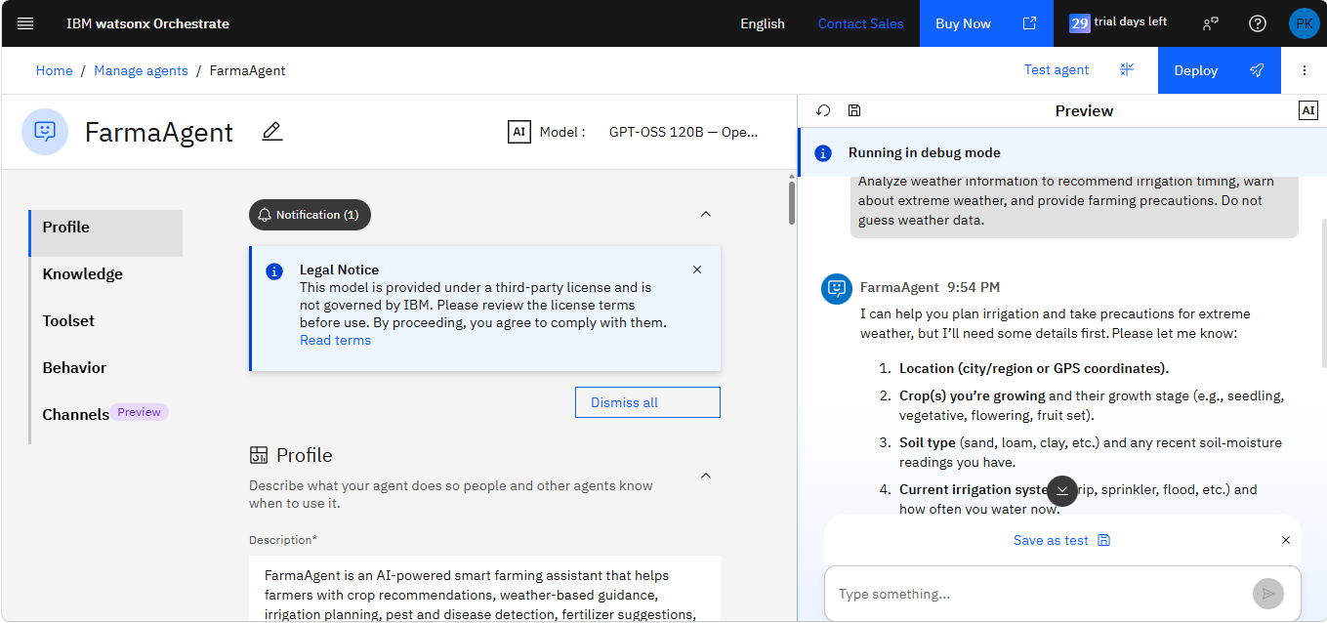
Prompt with output Screenshot:

Slide 9
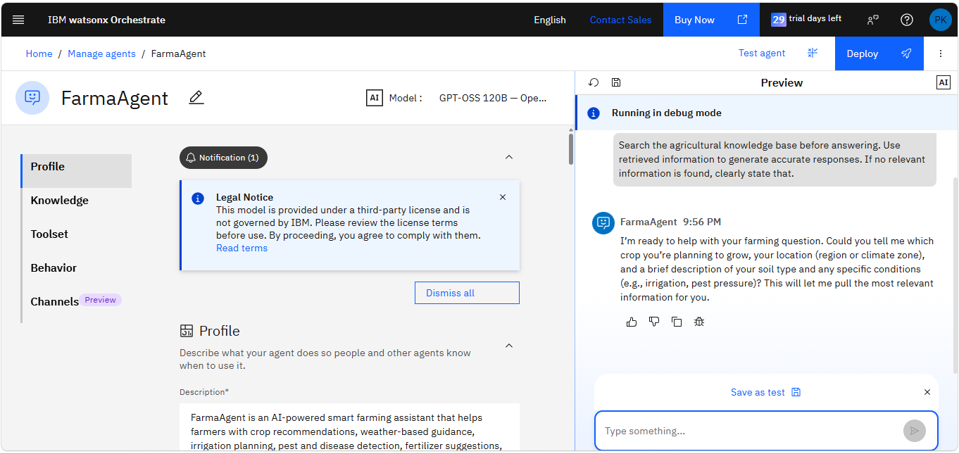
Other Applicable Screenshots:

Slide 10
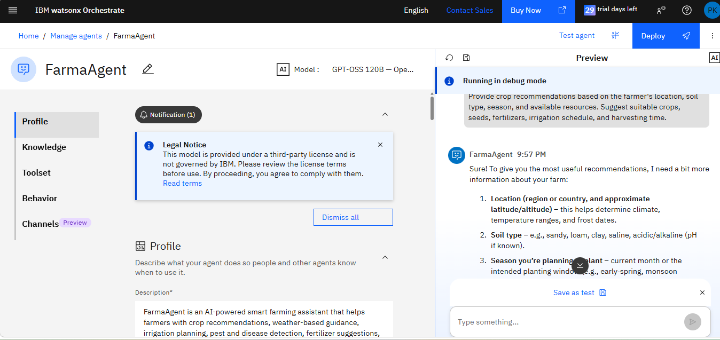

Slide 11
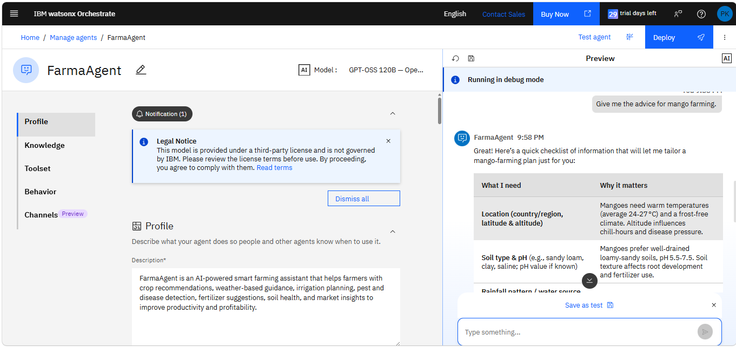

Slide 12
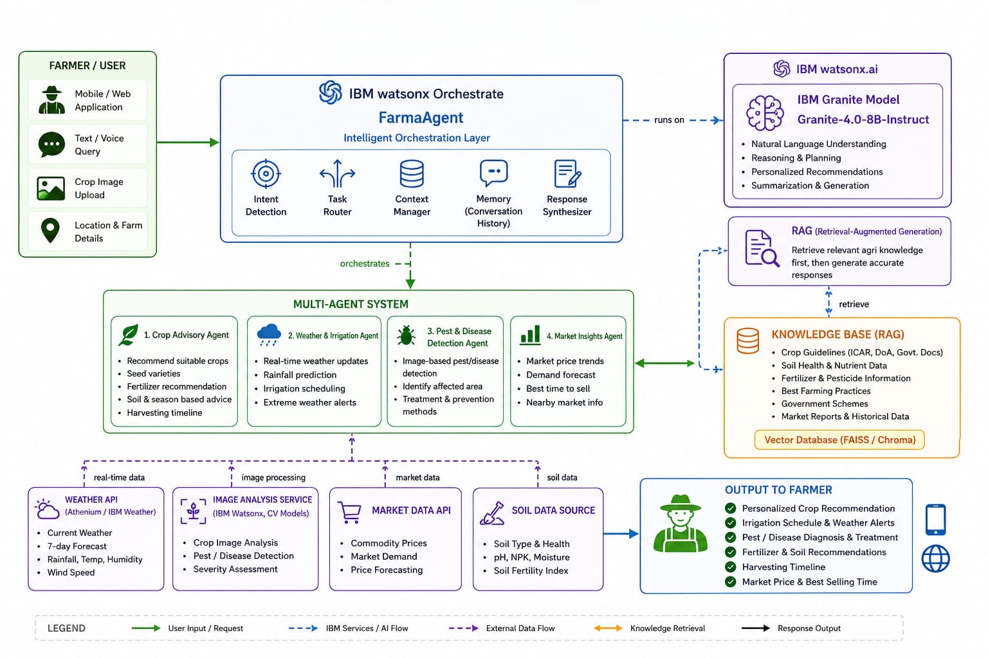
Orchestrate architecture blueprint

Slide 13

Role of Agentic AI in the solution
Role of Agentic AI in FarmaAgent
Agentic AI enables FarmaAgent to function as an intelligent, autonomous farming assistant rather than a simple chatbot. Using IBM watsonx.ai, IBM Granite models, and IBM watsonx Orchestrate, it coordinates multiple specialized agents to deliver personalized and real-time agricultural guidance.
Each agent performs a dedicated role—such as providing crop recommendations, analyzing weather conditions, detecting pests and diseases from crop images, and offering market insights—while collaborating with other agents to generate accurate and comprehensive farming advice. This multi-agent architecture ensures efficient task execution and better decision-making.
Agentic AI is context-aware, understanding farmer-specific information such as crop type, soil conditions, location, season, and farming goals to generate personalized recommendations.

Slide 14
Novelty and Uniqueness
The proposed FarmaAgent stands out by combining Agentic AI, Retrieval-Augmented Generation (RAG), real-time data integration, and personalized farming recommendations into a single intelligent agricultural assistant.
Multi-Agent Intelligence – Instead of a single chatbot, multiple specialized agents collaborate to provide crop advisory, weather forecasting, pest and disease detection, and market insights.
RAG-Based Accuracy – Retrieves trusted agricultural knowledge, government advisories, and crop guidelines before generating responses, ensuring reliable and evidence-based recommendations.
Personalized Farming Advice – Generates customized recommendations based on the farmer's location, soil type, crop, season, and farming conditions.
Real-Time Decision Support – Continuously updates recommendations using live weather forecasts, soil information, and market price trends.
Multi-Modal Interaction – Supports text queries, voice commands, and crop image uploads for pest and disease identification.
Sustainable Agriculture Focus – Promotes efficient irrigation, balanced fertilizer usage, early pest detection, and cost-effective farming practices to improve productivity while protecting natural resources.

Slide 15
Git Hub Link
https://github.com/payalkarvande10-byte/Smart-Farming-Advice-AI-Agent-FarmaAgent-
·
·
·

Slide 16
Future Scope
IoT Integration – Connect with smart sensors to monitor real-time soil moisture, temperature, humidity, and nutrient levels for precise farming decisions.
Drone & Satellite Monitoring – Integrate drone imagery and satellite data to monitor crop health, detect diseases early, and estimate crop yield.
Multilingual Voice Assistant – Support regional languages and voice-based interactions, making the system accessible to farmers with different literacy levels.
Predictive Analytics – Use AI to forecast crop yield, pest outbreaks, and climate risks, enabling proactive farm management.
Smart Irrigation Automation – Integrate with automated irrigation systems to optimize water usage based on weather forecasts and soil conditions.
Government & Financial Services Integration – Provide information on government schemes, crop insurance, subsidies, and agricultural loans within the platform.
Blockchain-Based Supply Chain – Improve transparency and traceability of agricultural produce from farm to market.
·
·
·

Slide 17
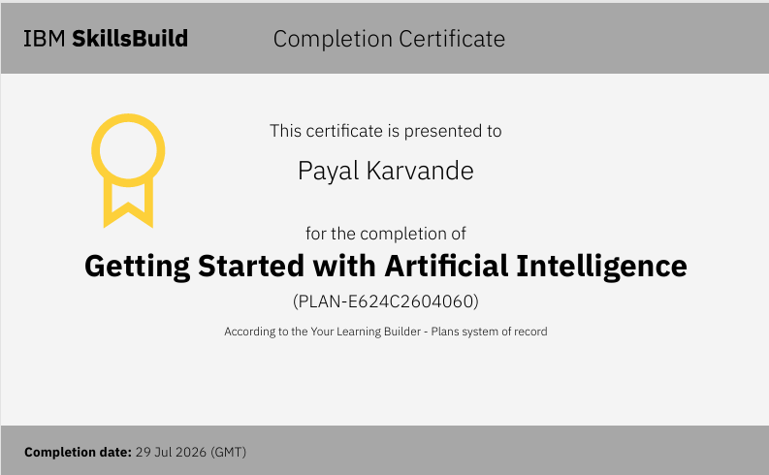
Certificates Earned:

Slide 18
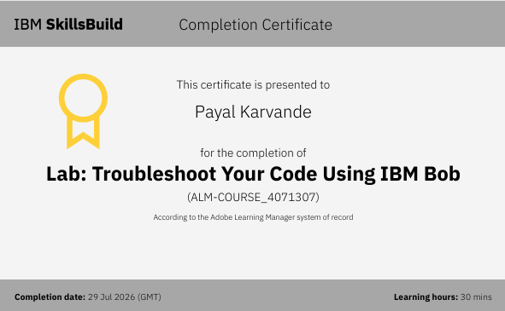
Certificates Earned:​

Slide 19


